Slide 1

Virtual Tour
Group 4

Slide 2
Member
Name | Student ID
Nguyễn Đặng Anh Dũng | 202414619
Trần Ngọc Huyền | 202414629
Nguyễn Lâm Tuấn Linh | 202414637
Phạm Ngọc Anh | 202414609
Vương Minh Đức | 202414617

Slide 3
Table of contents
01
04
02
05
03
06
Idea and Objectives
Blocks Design
Functions and
Non-functions
Software Showcase
References
Planning

Slide 4
01
Idea and Objectives

Slide 5
Idea and Objectives
Project inspiration
Inspired by virtual tours from the University of Technology Sydney, Harvard University, and the Vietnam Military History Museum, we aim to develop a software that allows users to experience virtual spaces without being physically present.
Objectives
Specifically, our goal is to create an immersive virtual tour of Hanoi University of Science and Technology (HUST), providing users with a realistic and engaging experience of the campus.

Slide 6
02
Functions and Non-functions

Slide 7
Functions and Non-functions
Functions | Non-functions
360 degree navigation | Peformance
Interact hotspots | Scalability
Multi-Platform Compatibility | Security
User Analytics | Usability
 | Maintainability

Slide 8
03
Planning

Slide 9
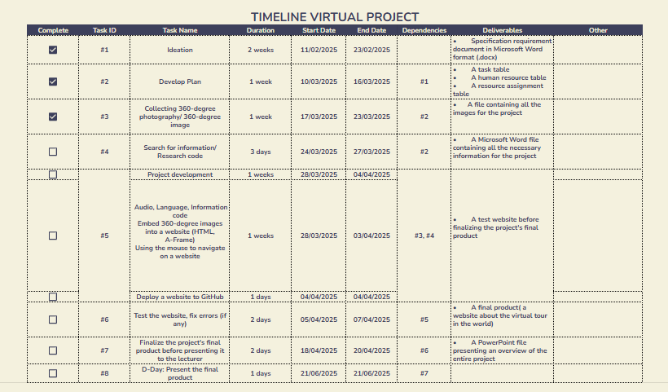
Planning

Slide 10
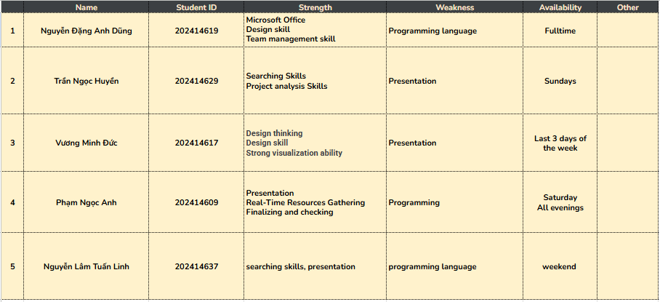
Planning

Slide 11
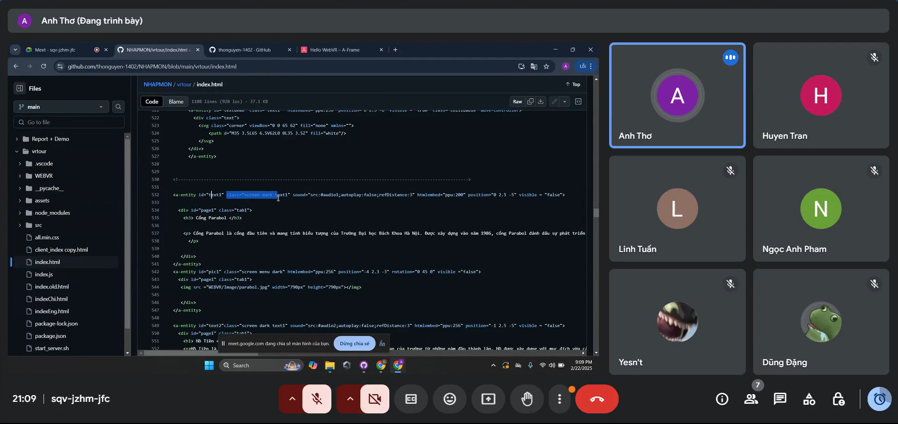
Our activities

Slide 12
04
Blocks Design

Slide 13
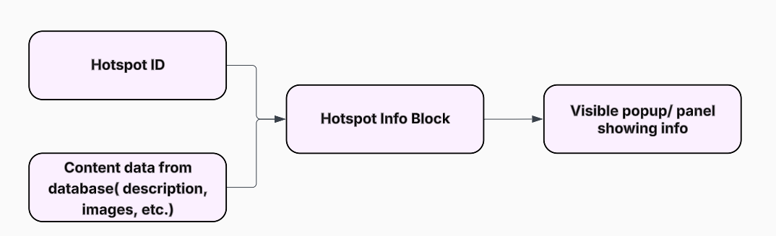
Block Design
Hotspot Info Block
Input
Output

Slide 14
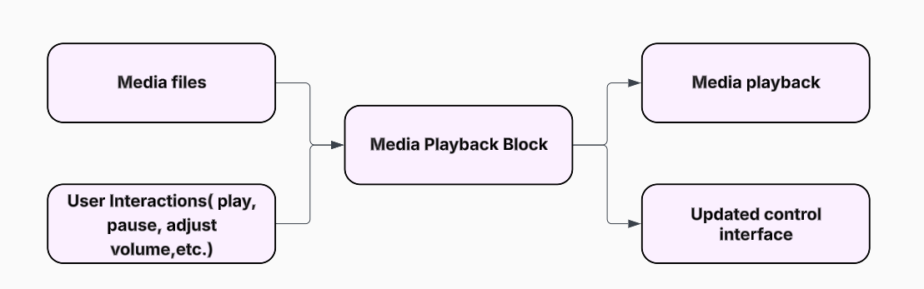
Block Design
Media Playback Block
Input
Output

Slide 15
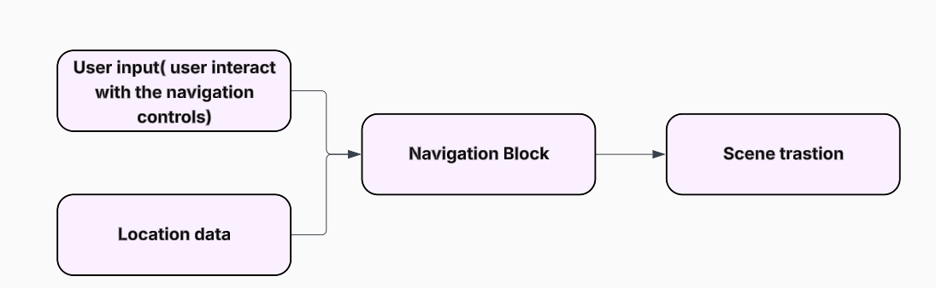
Block Design
Navigation Block
Input
Output

Slide 16
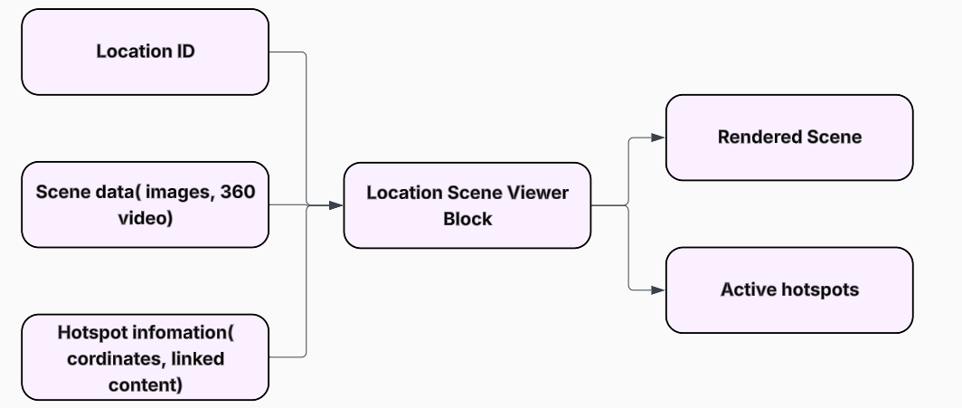
Block Design
Location Scene Viewer Block
Input
Output

Slide 17
05
Software Showcase

Slide 18

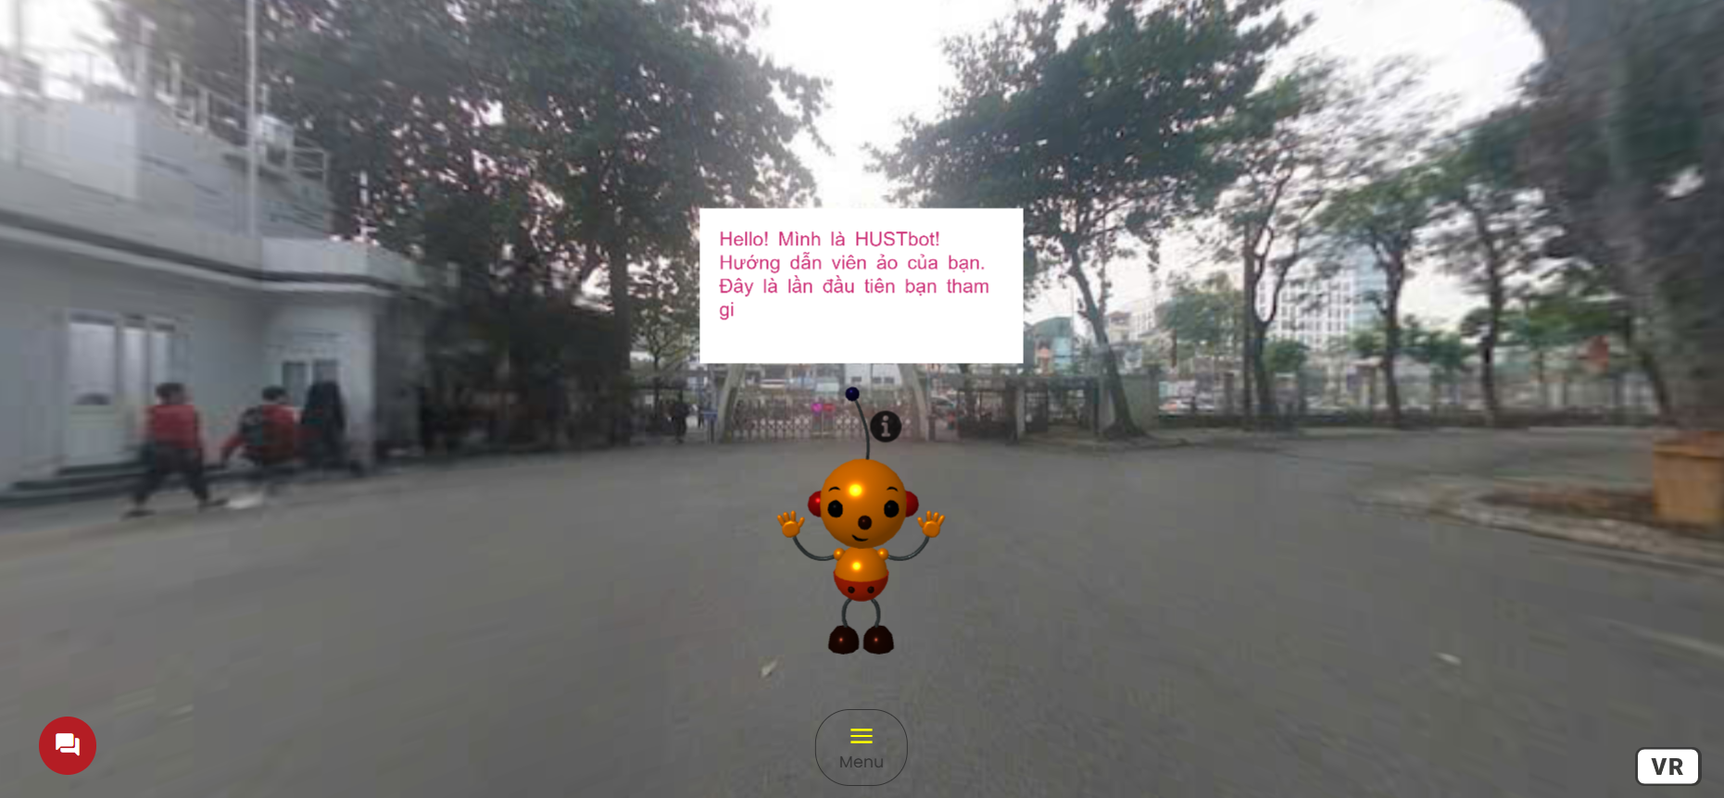
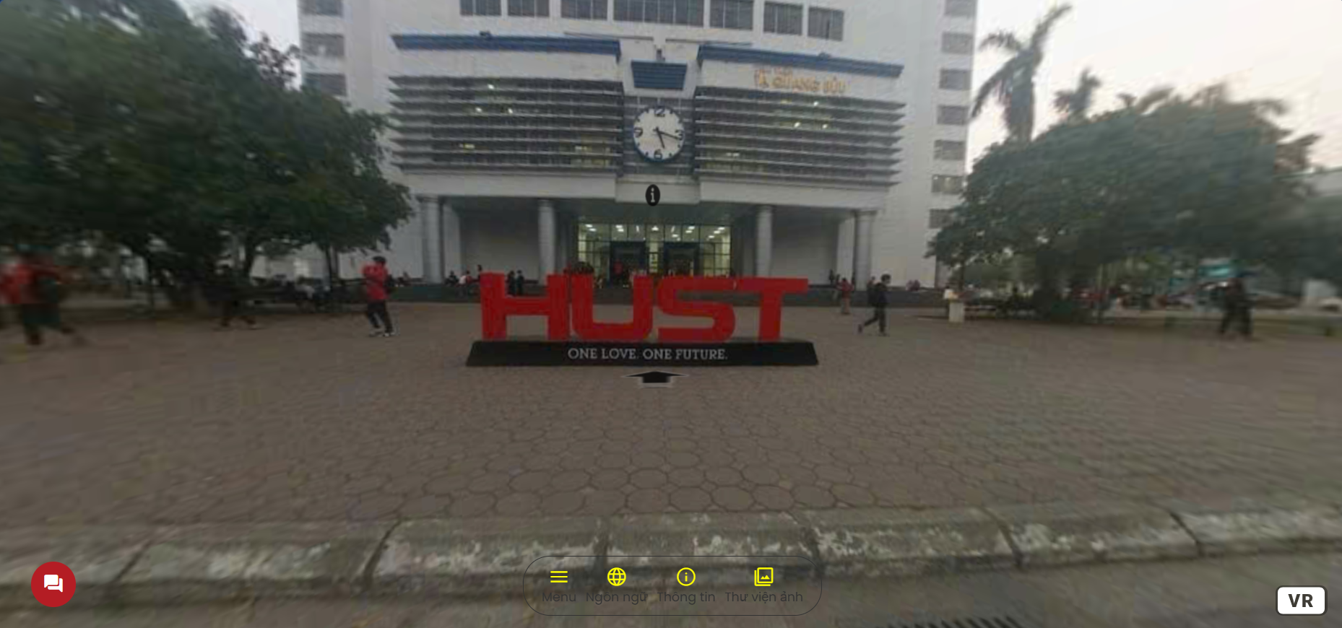
Software Showcase
Loading screen
Initial tour screen
Other place

Slide 19
Software Showcase
Information about the place
Chatbot
Navigation arrow
Menu
VR mode

Slide 20

Software Showcase
HUST TOUR

Slide 21
06
References

Slide 22
References
University of Technology Sydney (UTS) Virtual Tour: https://tour.uts.edu.au/
Harvard University Virtual Tour: Virtual Tour | Harvard
Vietnam Military History Museum: https://www.klapty.com/p/thanh-hoan/t/vietnam-military-history-museum-virtual-tour-93465
Code: https://github.com/thonguyen-1402/NHAPMON/tree/main
Google AI for Developers, Gemini API docs: https://ai.google.dev/gemini-api/docs

Slide 23
Thanks for watching and listening!

